Slide 1
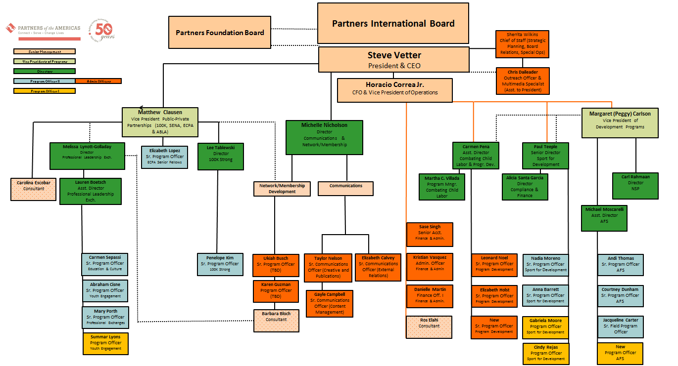
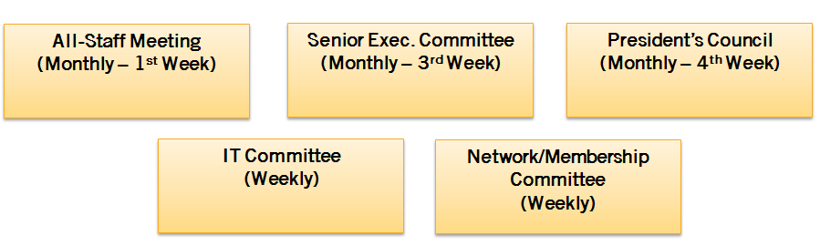
Team of Teams
NEW 2015 Org Chart
+
Strategic Leadership Committees

Slide 2

NEW 2015 Organizational Chart

Slide 3
2015 Strategic Leadership Committees
& Special Staff Meetings
All-Staff Meeting
(Monthly – 1st Week)
Senior Exec. Committee
(Monthly – 3rd Week)
President’s Council
(Monthly – 4th Week)
IT Committee
(Weekly)
Network/Membership Committee
(Weekly)

Slide 4
Monthly All-Staff Meeting
Function:
The all-staff meeting is primarily for information sharing across Partners’ staff. The expectation is that each office within the organization present a brief update on relevant business travel, key meetings/events, partnership and program opportunities and needs for support. While questions and open discussion are welcome, these meetings are not designed to be strategy sessions.
Chair:
Sherrita Wilkins, Chief of Staff
responsible for setting the meeting schedule and agenda.
Standing Members:
DC Staff and Interns
Meeting Schedule:
July 6th
August 3rd
September 1st
October 5th
November 2nd
December 7th

Slide 5
Senior Executive Committee
Function:
This meeting is designed to be a “prep session” for the all staff meeting as well as oversee large policy and procedural issues (i.e. budget, performance reviews, board issues etc.)
Chair:
Steve Vetter, President & CEO
Works in coordination with senior leadership and the Chief of Staff to set the meeting’s schedule and agenda.
Standing Members:
Peggy Carlson, Matt Clausen, Horacio Correa, Sherrita Wilkins, Steve Vetter
Meeting Schedule:
July 27th
August 24th
September 28th
October 26th
November 30th
December 18th

Slide 6
President’s Council
Function:
This committee meets monthly (typically the 3rd week) or at the discretion of the President to discuss issues of overall organizational importance. It is NOT an IT decision making body but it can provide recommendations that factor into IT and or membership/ network related concerns. As there will now be internal forums for both IT and Membership/ Network, this space can be reserved for financial, planning, strategic, or other conversations that require the input and participation of senior staff.
Chair:
Steve Vetter, President & CEO
Works in coordination with senior leadership and the Chief of Staff to set the meeting’s schedule and agenda.
Standing Members:
Program/Unit Directors, VPs and Senior Management
(Peggy Carlson, Matt Clausen, Horacio Correa, Melissa Golloday, Michelle Nicholson, Carmen Peña, Alicia Santa, Sherrita Wilkins, Steve Vetter)
Meeting Schedule:
June 22th
July 20th
August 17th
September 14th
October 19th
November 16th
December 14th

Slide 7
IT Committee
Function:
This committee’ shares expertise on IT and technology issues within Partners. The purpose of the committee is to provide recommendations to Sr. Mgmt. and the Communications Director as to how to start, close, implement, or otherwise proceed with technology related items. This includes the website, databases, membership platforms, software, and other systems used or to be used by Partners staff. This is NOT a decision making body. It IS an advisory and feedback body. Decisions on tech matters are the sole responsibility of Sr. Mgmt. in consultation with Michelle
Chair:
Horacio Correa, CFO & VP of Operations
responsible for setting the meeting’s schedule and agenda.
Standing Members:
Ukiah Busch, Liz Calvey, Peggy Carlson, Horacio Correa, Michelle Nicholson, (Steve Vetter as needed)
Meeting Schedule:
Weekly

Slide 8
Network/Membership
Committee
Function:
This committee provide feedback around membership and network issues. This would give programs and units a place to air concerns regarding how membership and network impact their programs or areas of responsibility. All staff are welcome to participate in the membership and network taskforce, but participation will be especially important for staff serving as POC’s. The membership and network taskforce will NOT be the location for having technology conversations around membership—that will happen in the IT Working group, allowing this committee to focus exclusively on issues such as value propositions, benefits to membership, issues within the network, processes such as rechartering, intersections between programs and the network, etc.
*The roles and responsibilities of POCs will be shared separately.
Chair:
Michelle Nicholson, Director of Communications & Network/Membership
responsible for setting the meeting’s schedule and agenda.
Standing Members:
Everyone in the newly combined Communications & Network/Membership Unit + Staff POCs
(Horacio Correa and Steve Vetter will participate as needed)
Meeting Schedule:
Weekly

Slide 9
NEW 2015 Organizational Structure & Midyear Goals Review Process
Date | Activity | Lead(s)
June 4 | Announce 2015 NEW Organizational Structure to DC Staff (begin feedback and adoption process) | Steve
June 9 - 19 | Send feedback to Program/Units on 2015 Goals & schedule meetings with Program/Unit Directors to review organizational priorities and provide in-person feedback on goals. | Sherrita
June 22 | Hold President’s Council Meeting to Share and Review Revised Mid-year Goals (team by team) | President’s Council
June 30 | Each Team Submits Final 2015 Goals. Begin Lifting Core 2015 Goals and Organizational Priorities into a Draft 2016-2018 Strategic Plan | Each Program/Unit
July 7 | Special Meeting of the Senior Executive Committee to Review & Finalize 2015 Corporate Goals for Submission to the Board. | Senior Exec Committee
July 9 | Send Corporate Goals and Draft Strategic Plan to Boards | Sherrita
July 23 | Tentative: Joint International & Foundation Board Meeting | Sherrita

